Slide 1
Name: Swapnil Ghosh
Dept: IT
Roll No: 001911001067
PROGRAM 4

Slide 2
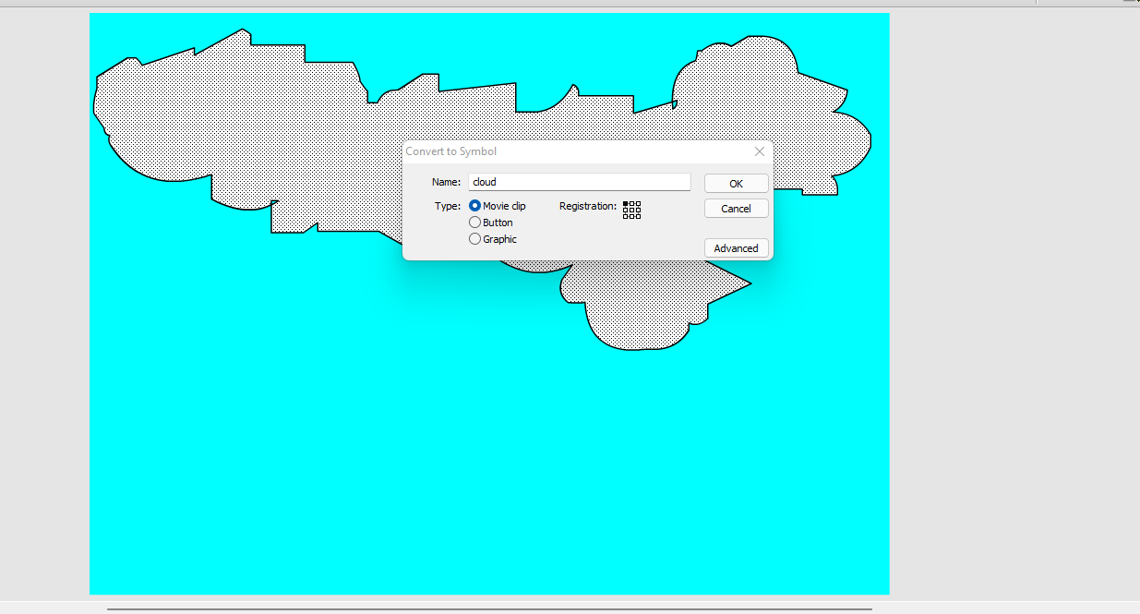
1.go to start- macromedia- click on flash document.
2. create a blue background in layer 1.
3. Now insert a layer 2 and draw the clouds in this layer.
4. in order to create the clouds, go to tool bar and select pencil option, draw the cloud in layer2.
5. fill the colour to the cloud, right click on it- choose convert to symbol option- give the name as cloud.
6. select the movie clip option and click ok.
7. Go to filter->click on the + symbol->select glow to apply glowing effect-> select the colour to white.

Slide 3
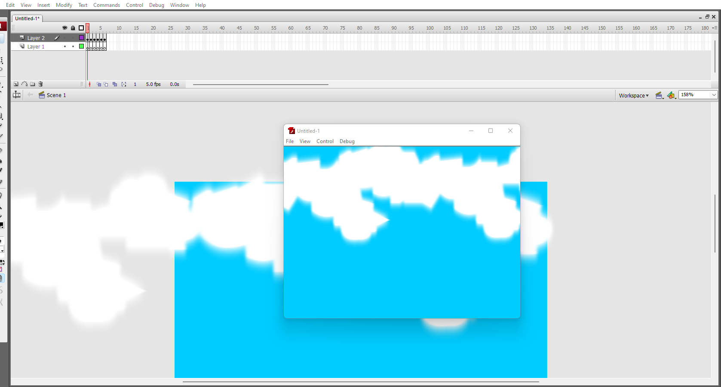
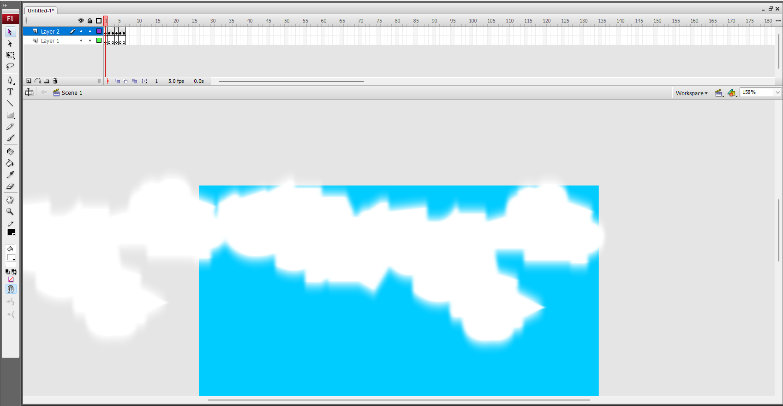
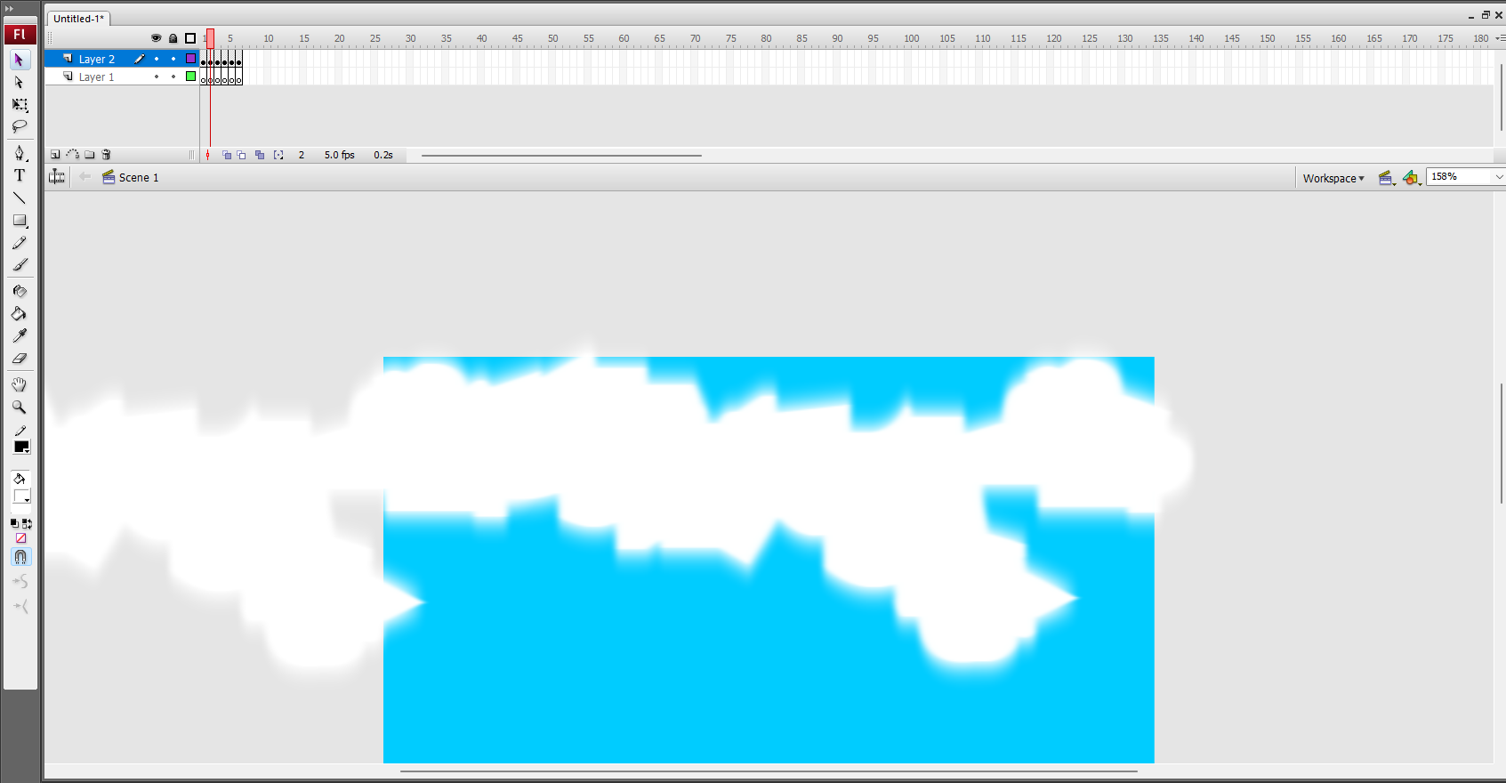
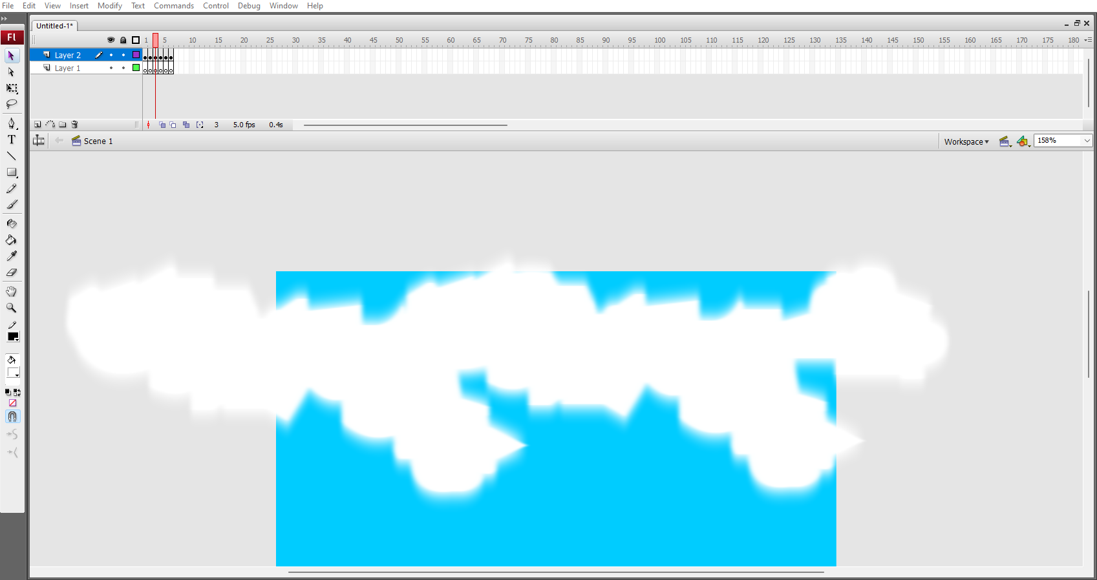
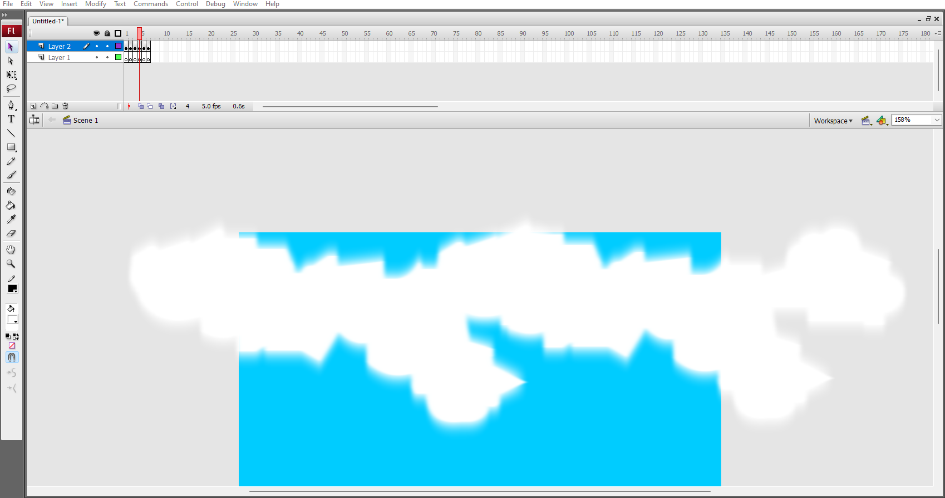
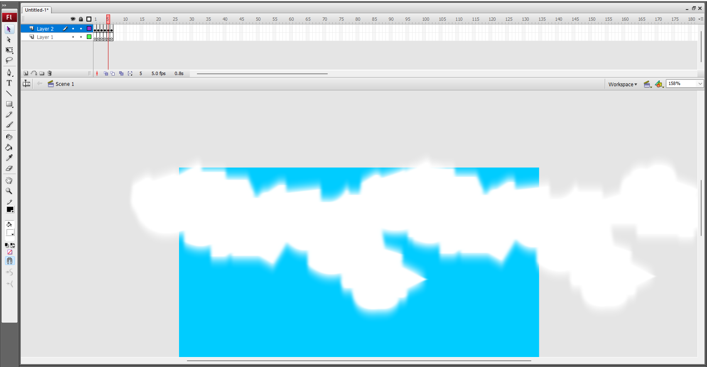
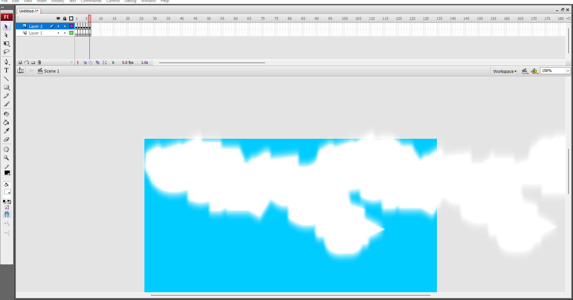
8. under glow and adjust the blur x/blur y values.
9. give the appropriate blur effect to the cloud.
10. go to frames, insert key frame on both the layer, create the motion tween on 2nd layer and move the clouds.
11. finally go to control->click on test movies

